Slide 1

END TERM DISSERTATION PART (2) “BiDIRECTIONAL-LSTM AND CNN FOR THE IMPROVEMENT OF TWITTER SENTIMENT ANALYSIS”
PRESENTED BY:
NAME: Prafful Choudhary
SUPERVISED BY:
NAME : Dr.Arun Solanki
DEPARTMENT OF COMPUTER SCIENCE AND ENGINEERING
GAUTAM BUDDHA UNIVERSITY
GREATER NOIDA-201310, UTTAR PRADESH, INDIA
JUNE,2021

Slide 2


CONTENTS
2

Slide 3

INTRODUCTION

Slide 4

Sentiment Analysis

Slide 5
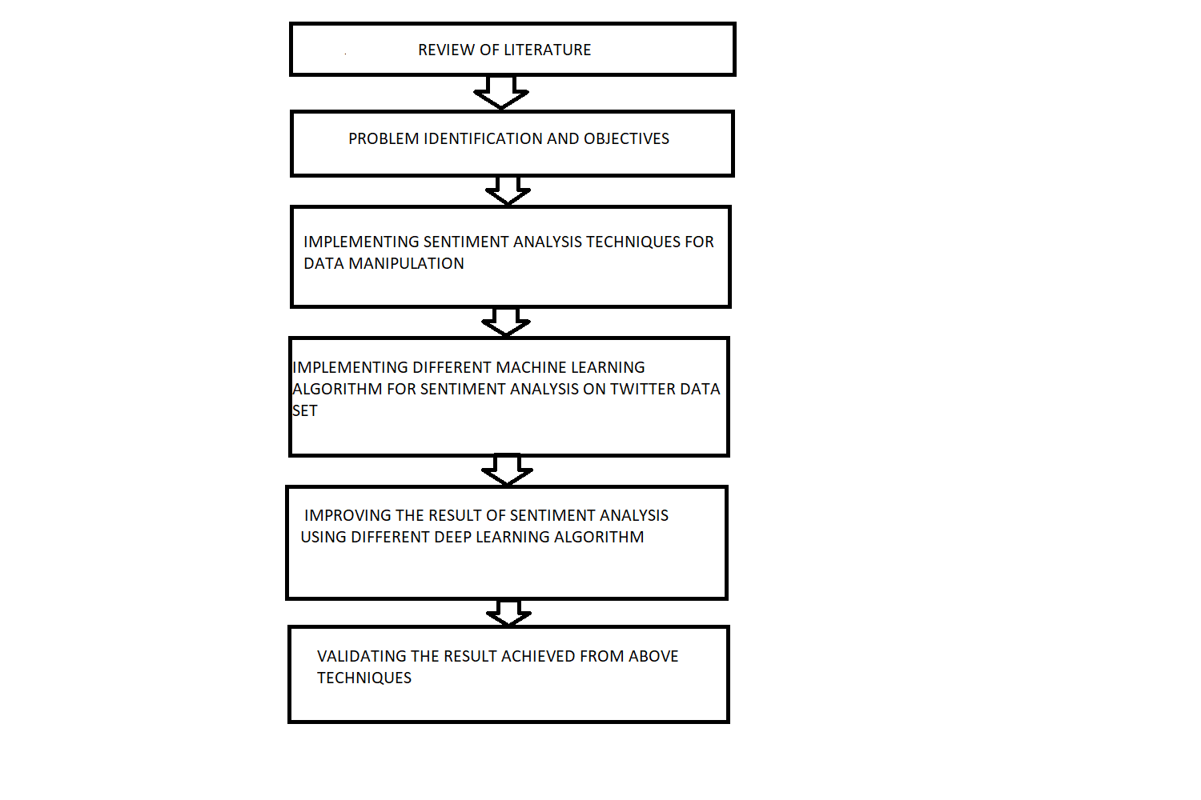
RESEARCH METHODOLOGY

Slide 6

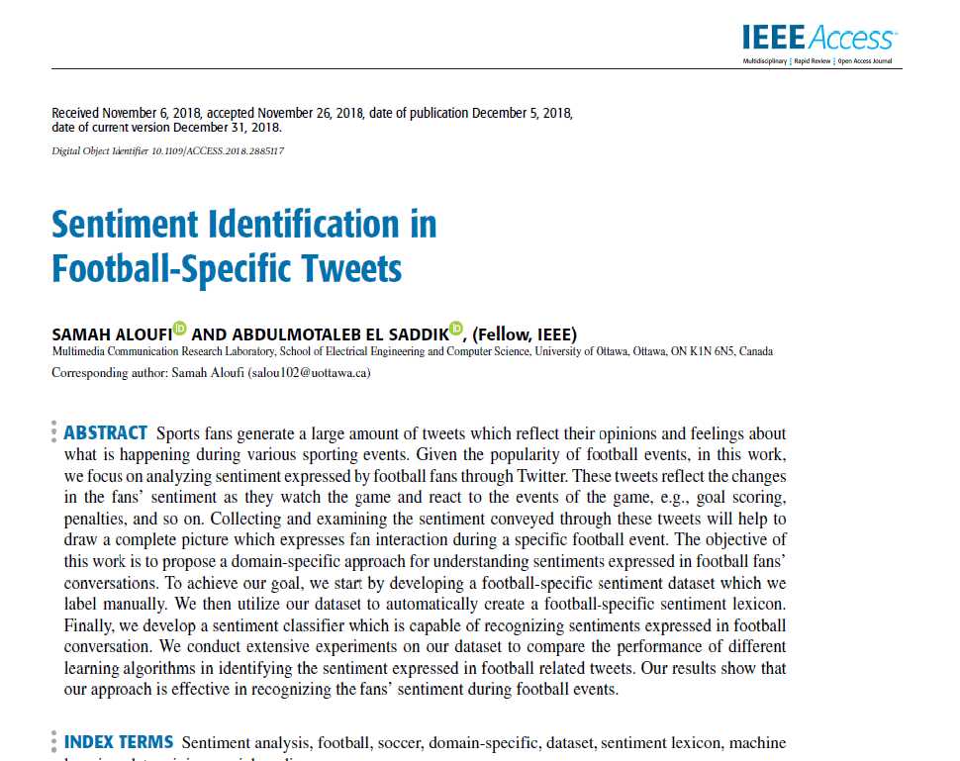
BASE PAPER INTRODUCTION

Slide 7
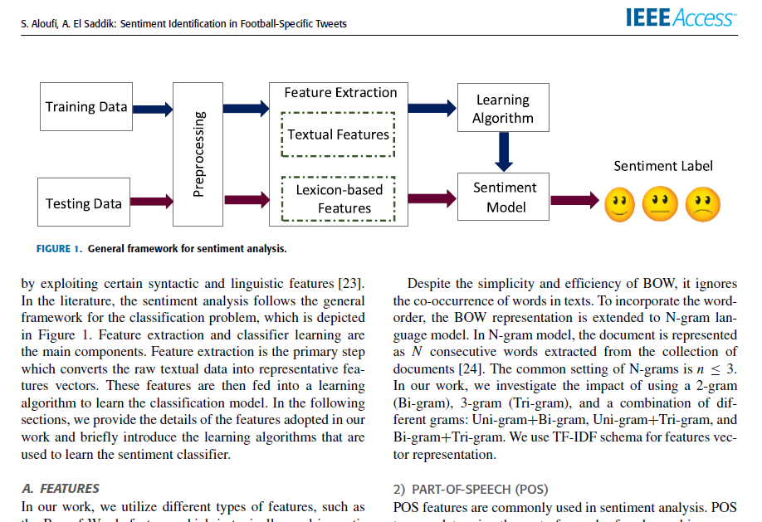
FRAMEWORK FOR SENTIMENT ANALYSIS

Slide 8
STUDY OF LITRATURE
TITLE , AUTHOR ,YEAR | METHODOLGY | FINDING | GAPS
R. Wankhede and A. N. Thakare, “Design approach for accuracy in movies reviews using sentiment analysis, in 2017 International conference of Electronics, Communication and Aerospace Technology (ICECA), | The author proposed the Random Forest method, for movie reviews data set in predicting the sentiment. The model when compared with Support Vector Machine (SVM), Hybrid SVM, Max Entropy, NB. By comparing the accuracy, | the author found that Random forest is giving a better accuracy of 90% when compared to other algorithms | With supervised learning methods is that we need to have well defined labelled data otherwise the training and testing is difficult to perform. A large amount of training set is required. x Data collection is tedious
L. Dey, S. Chakraborty, A. Biswas, B. Bose, and S. Tiwari, “Sentiment Analysis of Review Datasets Using Naïve Bayes‘ and K-NN Classifier,” Int. J. Inf. Eng. Electron. Bus.,, Jul. 2016. | The author concludes that the Naive Bayes algorithm gives better results when compared with K-NN based on the experiment results. The experiment is conducted on movie reviews dataset using two supervised algorithms (NB and K-NN). NB approach outperforms K-NN giving 80% accuracy. | Since the accuracy of Naïve Bayes algorithm is high in giving better results for movie reviews dataset, it is considered to use in this research to know whether it performs the same on the selected dataset of Twitter data. | Classifier trained on the texts in one domain in most cases does not work with other domains. Large storage required. x Computationally intensive recall.
Active Learning for Telugu Sentiment Analysis.”Active_Learning_for_Telugu_Sentiment_Analysis | The author addressed the problem for annotating labels for unlabeled Telugu data using limited dataset. To handle this hybrid approach is proposed by combining different query selection strategy framework to increase more accurate training data instances with smaller datasets. For this, the author used SVM, XG boost | Since the precision of XGBoost algorithm is high in giving better results for the unlabeled dataset, it is considered to use in this research to know whether it performs the same on the selected dataset of Twitter data and to know its accuracy value

Slide 9
LITRATURE SURVEY
TITLE , AUTHOR ,YEAR | METHODOLGY | FINDING | GAPS
A. Yenter and A. Verma, “Deep CNN-LSTM with combined kernels from multiple branches for IMDb review sentiment analysis,” in 2017 IEEE 8th Annual Ubiquitous Computing, Electronics and Mobile Communication Conference (UEMCON), 2017 | The author proposed about CNN+LSTM model on IMDB dataset where the author found that the model was able to predict the sentiment polarity of the reviews with an accuracy of 89.5%. | In future work that the efficiency of the model can be improved by word embedding and other pre-processing techniques. it can be used in this research to know whether it performs the same on the selected dataset of Twitter data. | With supervised learning methods is that we need to have well defined labelled data otherwise the training and testing is difficult to perform.
Q. Huang, R. Chen, X. Zheng, and Z. Dong, “Deep Sentiment Representation Based on CNN and LSTM,” in 2017 International Conference on Green Informatics (ICGI), 2017 | The author has introduced a model by combining one-layer of CNN with two-layer LSTMs for sentiment representation. The convolution layer and pooling layer in CNN make it easy to automatically extract local features and | reduce the computation complexity. Besides this LSTM is introduced to learn syntax features of linguistics. The results show that the proposed CNN-LSTM model outperformed CNN and SVM with an accuracy of 87.2%.
“Tweet sentiment analysis with classifier ensembles - ScienceDirect.” : 09-Jun- 2019 | Classifier ensembles and lexicons are used in the automatic classification of the sentiment of tweets. In concern to the query, the tweets are classified as positive or negative | Classifier ensembles formed by the models like SVM, Logistic Regression, Multinomial Naïve Bayes, Random Forest improves the classification accuracy on the sentiment datasets of the public tweets are shown by their experiment

Slide 10
IMPROVEMENT BY DEEP LEARNING ALGORITHM
Traditional machine learning techniques, including support vector machine (SVM), random walk, and so on, have been applied in various tasks of text sentiment analysis, which makes poor generalization ability in terms of complex classification problem.
In recent years, deep learning has made a breakthrough in the research of Natural Language Processing. Convolutional neural network (CNN) and recurrent neural networks (RNNs) are two mainstream methods of deep learning in document and sentence modeling.
In this paper, a model of capturing deep sentiment representation based on CNN and Bidirectional long short-term memory recurrent neural network (Bi-LSTM) can be used
The model uses the pre-trained word vectors as input and employs CNN to gain significant local features of the text,, which can extract context-dependent features and generate sentence representation for sentiment classification.
.

Slide 11
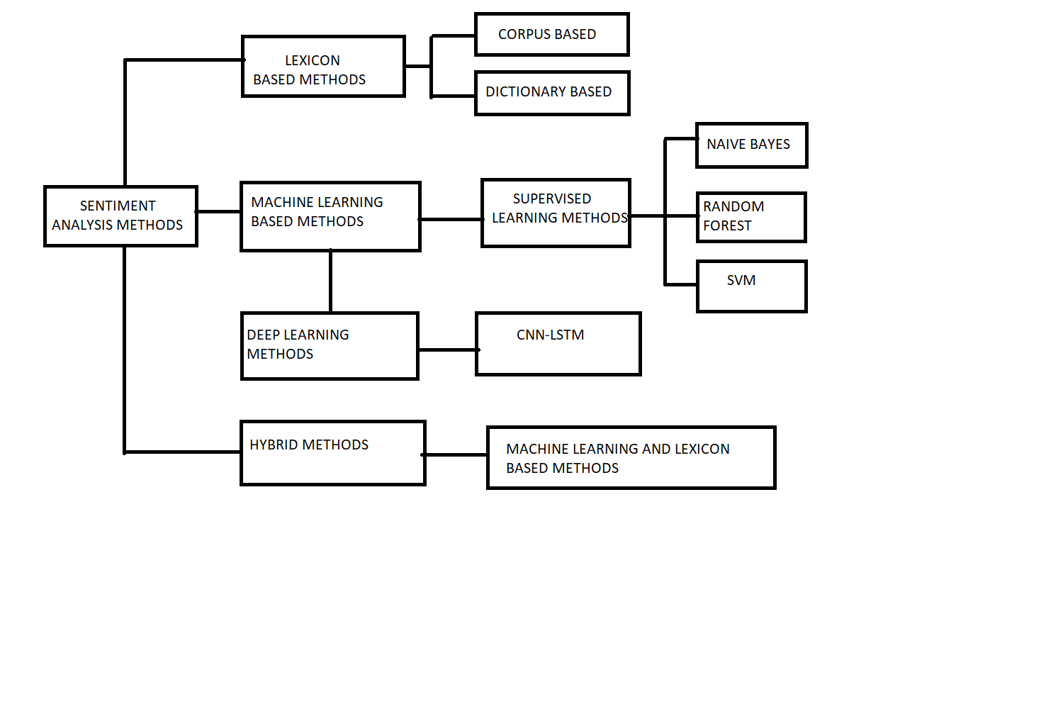
Flow Chart

Slide 12
RESEARCH OBJECTIVES
Objective 1:
Objective 2:
Objective 3:
Objective 4:
Objective 5:
To identify the algorithms and metrics for evaluating the performance of Machine Learning Classifiers.
To compare the metrics obtained from different machine learning algorithms depending on the size of datasets.
To identify which algorithm is better suited for sentiment analysis
Provides the Hybrid Deep Learning algorithms that help in improving the performance of sentiment analysis on Twitter data.
Envisions the best-fit algorithm for the selected dataset in conducting sentiment analysis on Twitter data

Slide 13
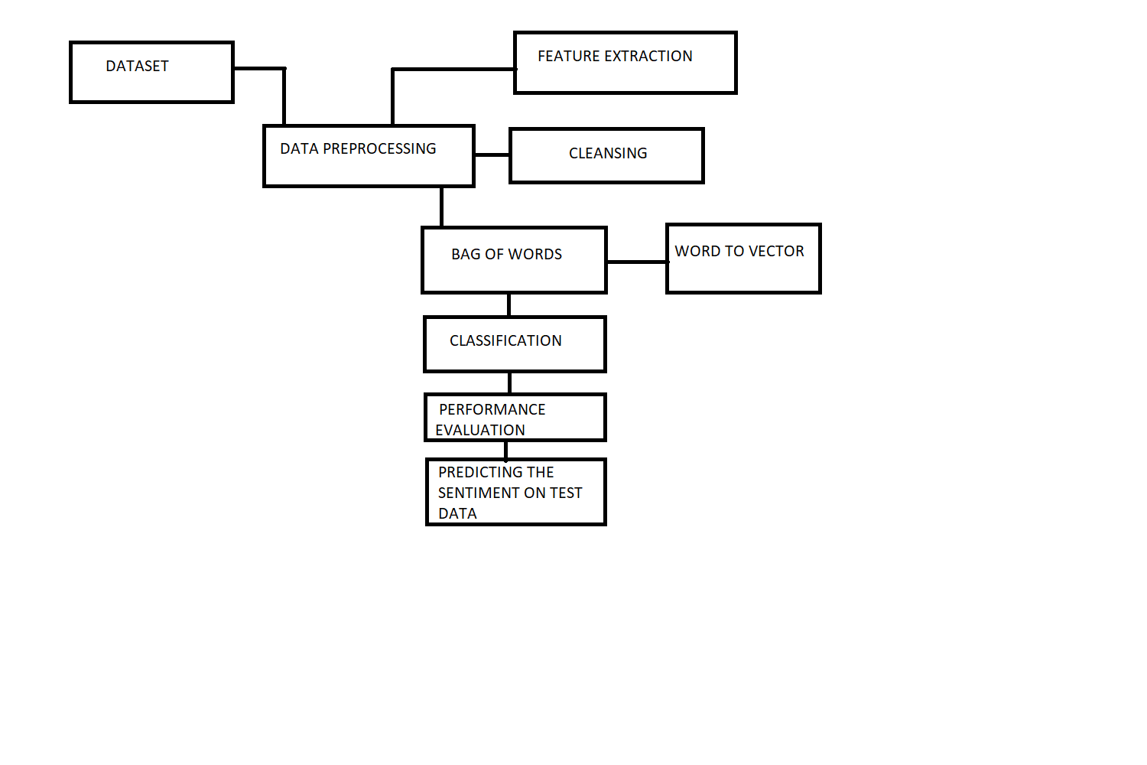
Flow Chart (2)

Slide 14
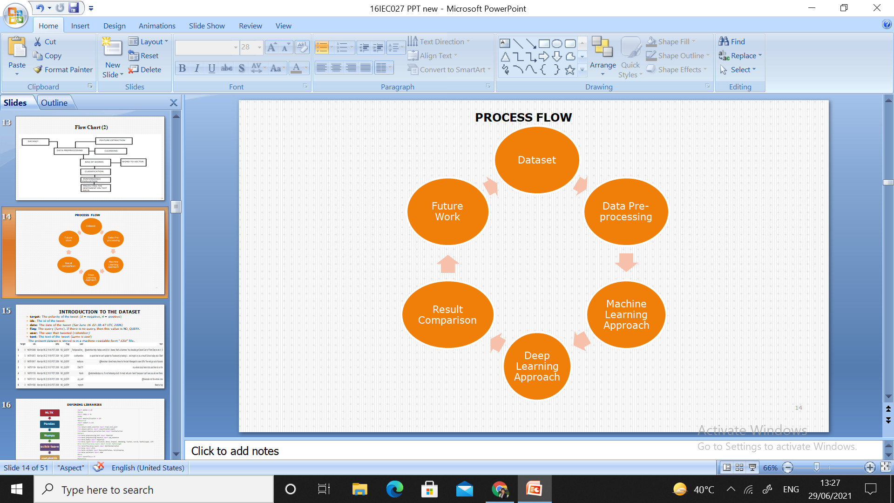
PROCESS FLOW

Slide 15
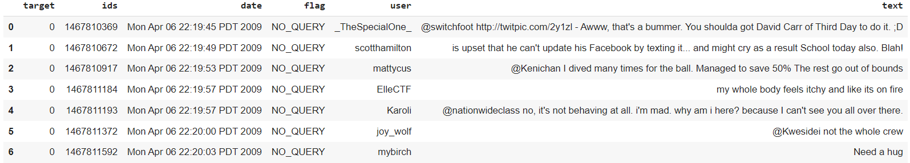
INTRODUCTION TO THE DATASET
target: The polarity of the tweet (0 = negative, 4 = positive)
ids: The id of the tweet
date: The date of the tweet (Sat June 16 02:38:47 UTC 2006)
flag: The query (lumx). If there is no query, then this value is NO_QUERY.
user: The user that tweeted (robotdozr)
text: The text of the tweet (Lumx is cool)
The present dataset is stored is in a machine-readable form “.CSV” file.

Slide 16
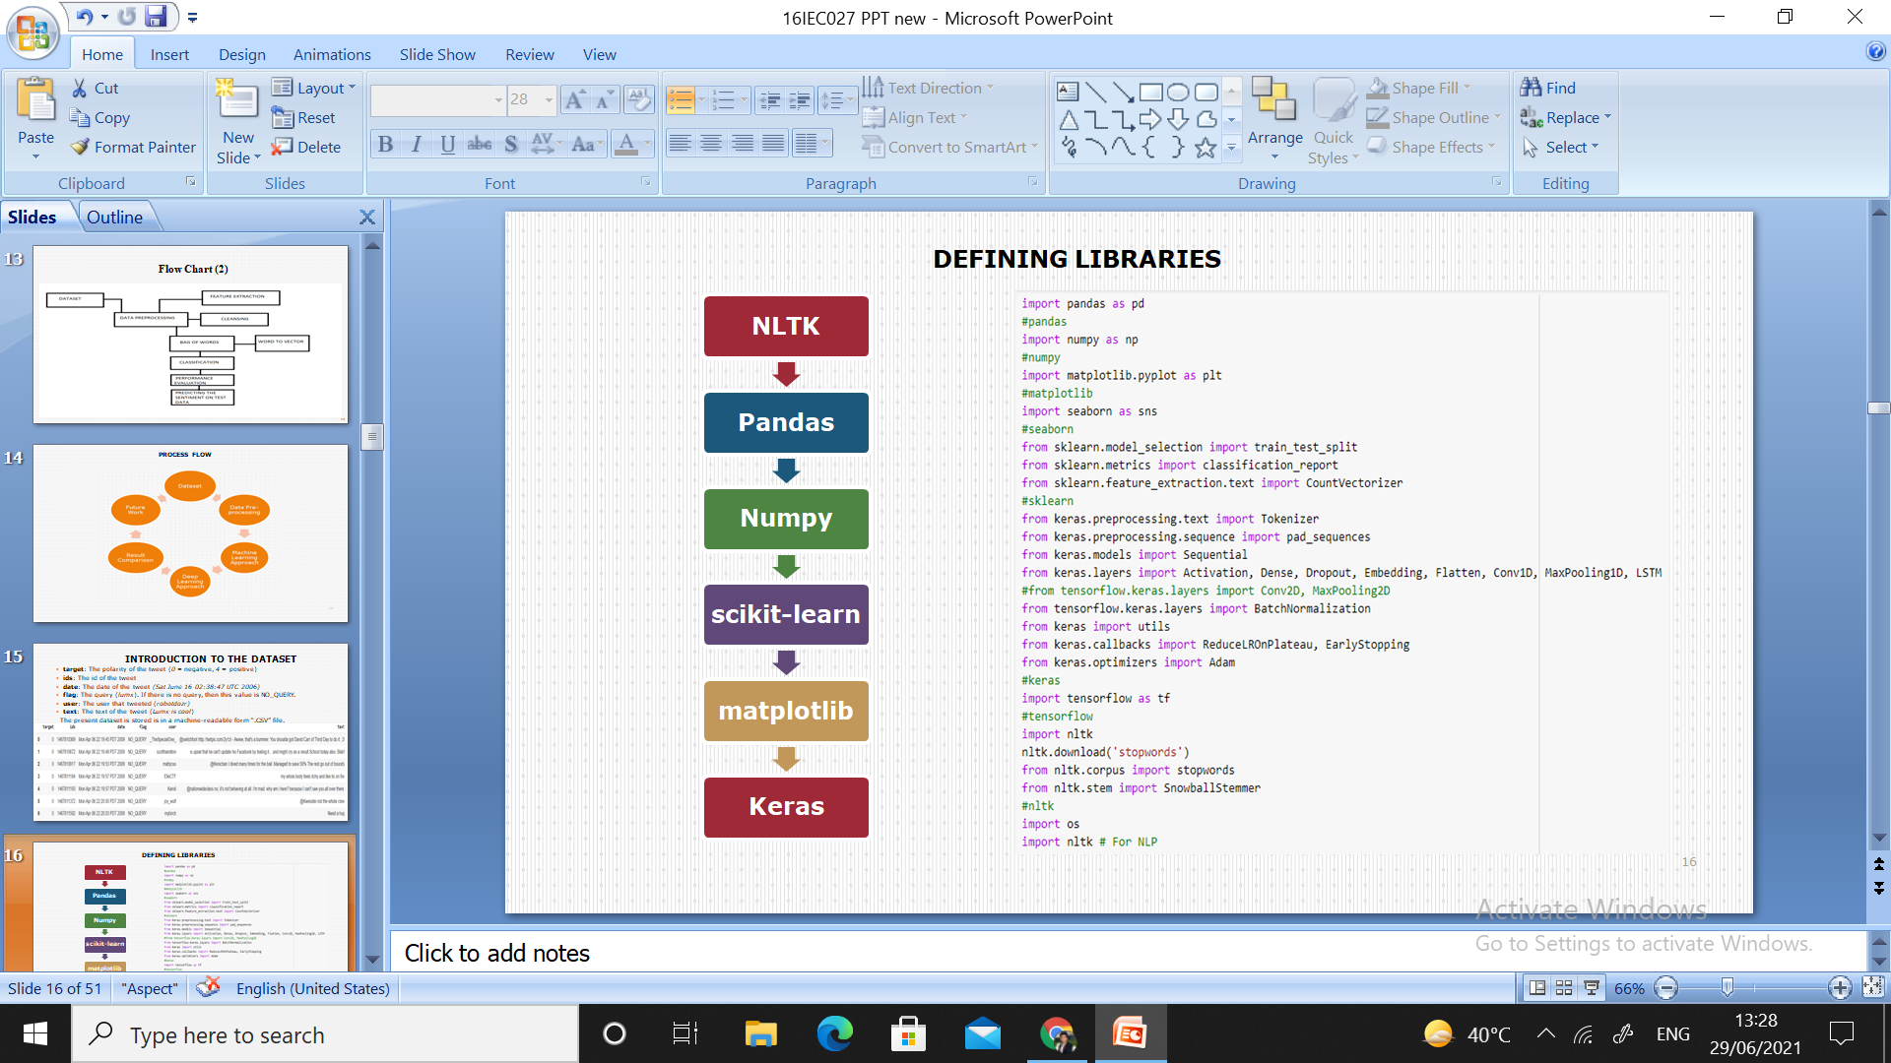
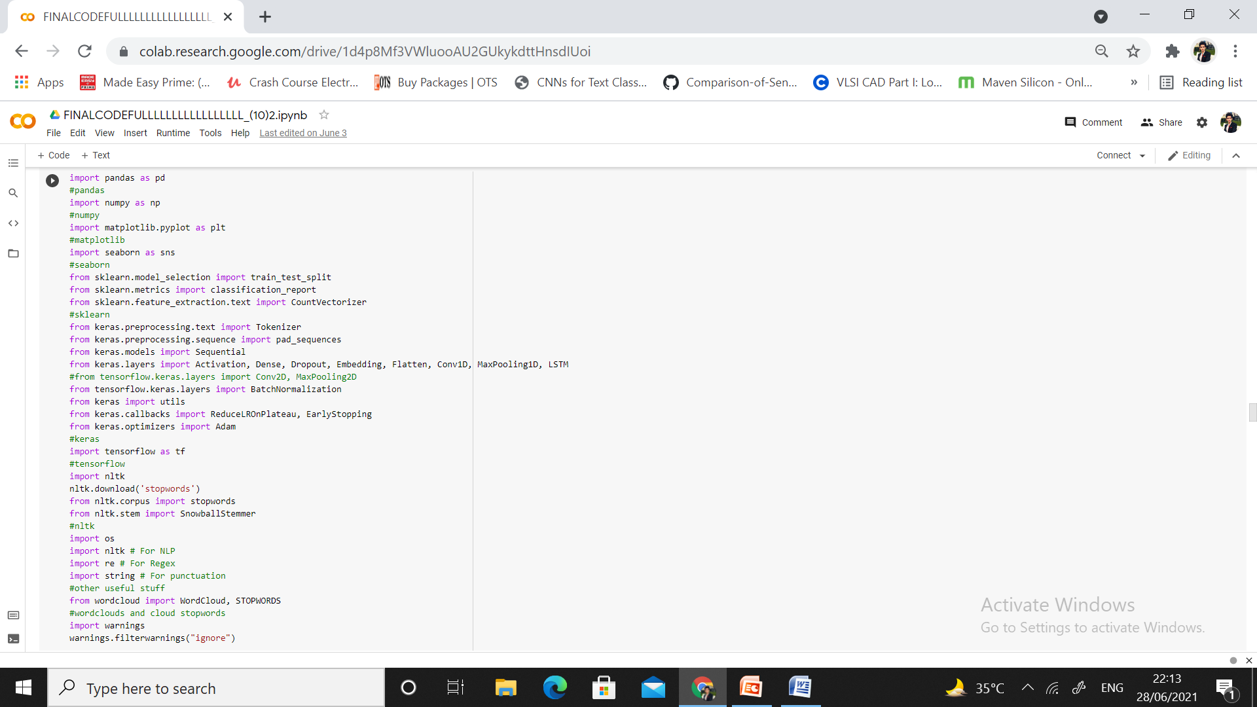
DEFINING LIBRARIES

Slide 17
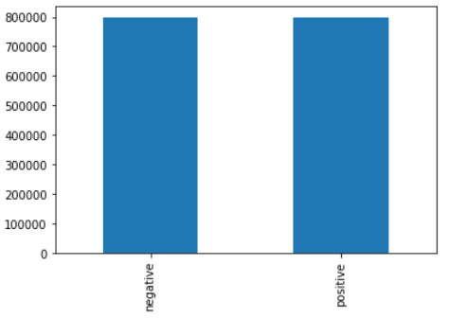
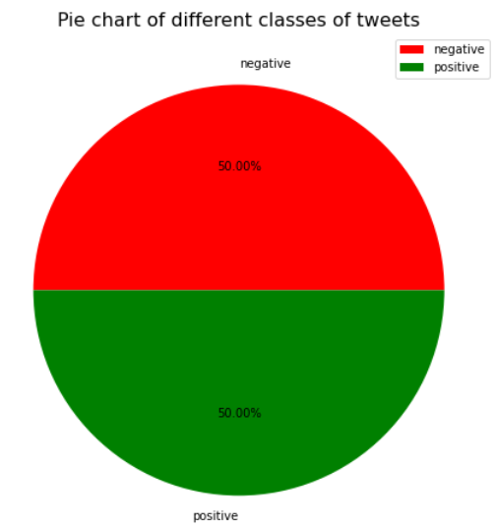
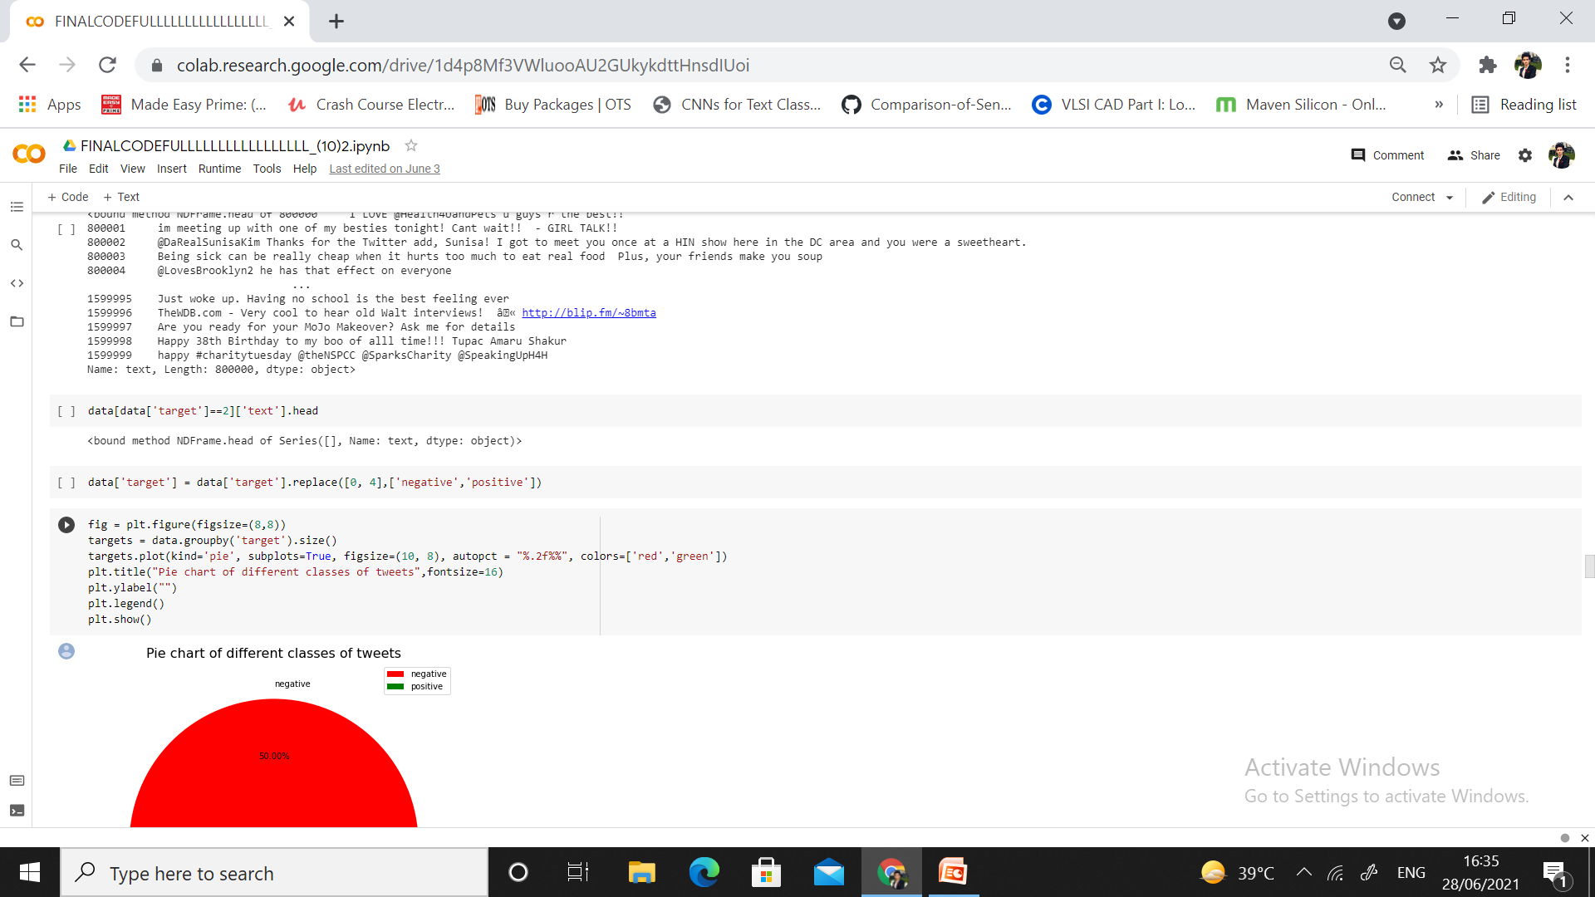
DATASET

Slide 18

STEPS FOR CLEANING THE DATASET

Slide 19
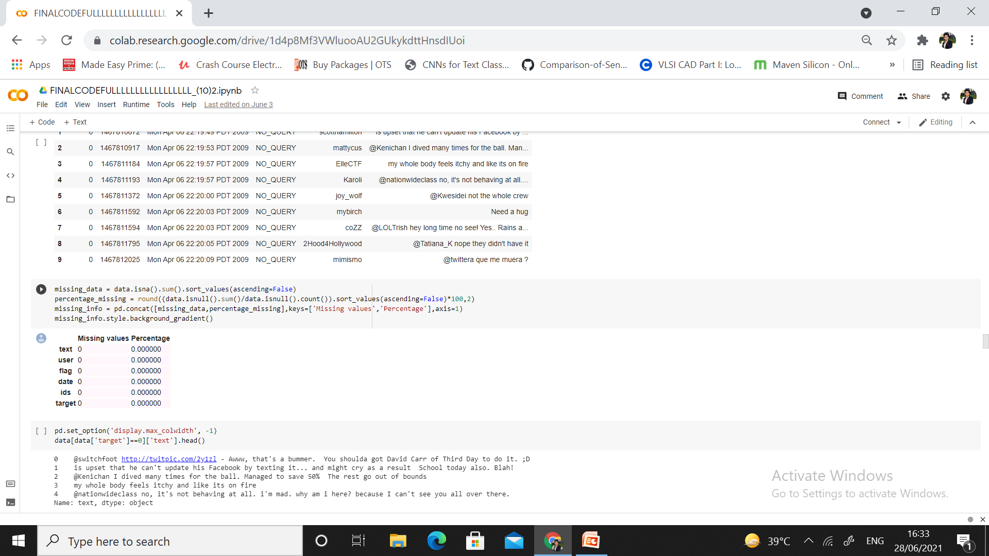
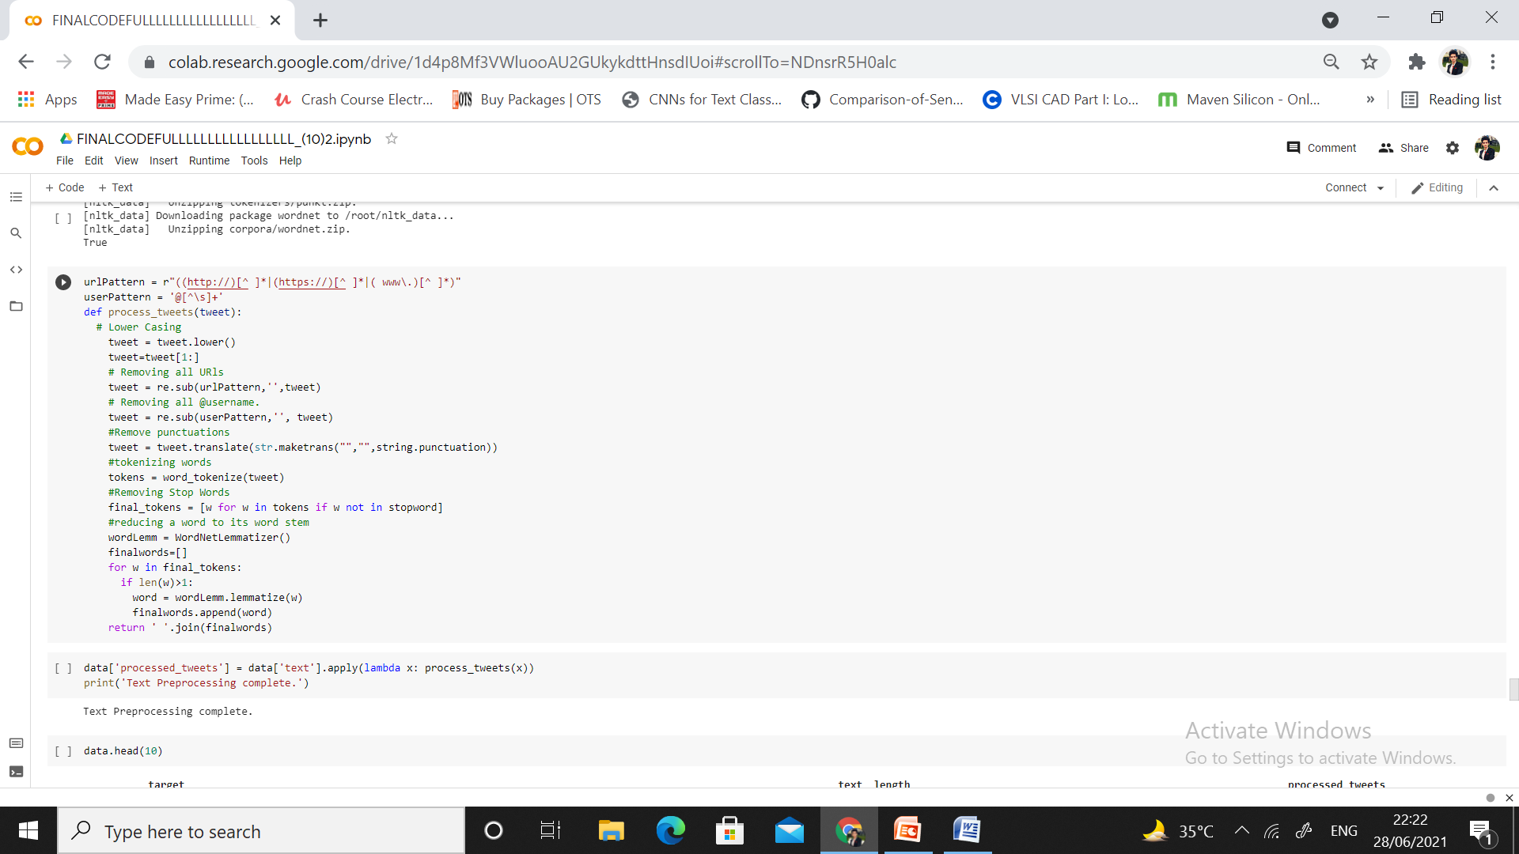
CODE FOR CLEANING THE DATASET
Tokenization is the way toward changing over tweet text into tokens before changing into vectors. It is simpler to channel superfluous tokens.
Stemming is the preparation of changing words over to their promise stem or root structure. E.g., fishes, fishing, Fisher is changed over to steam fish.

Slide 20
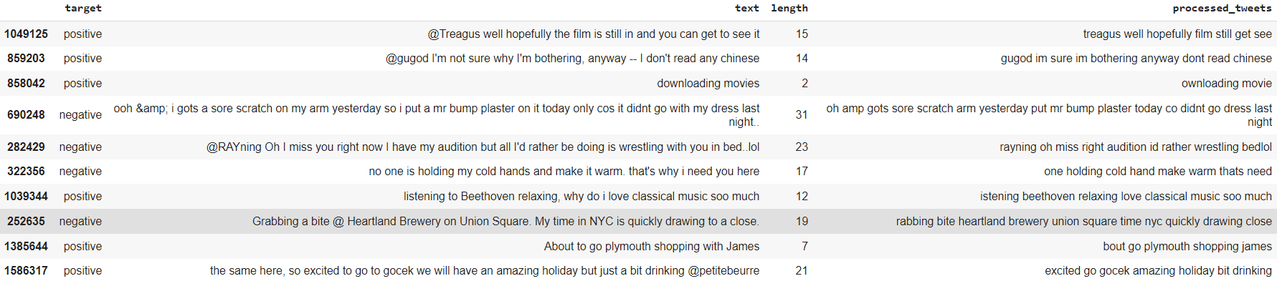
CLEANED DATASET

Slide 21
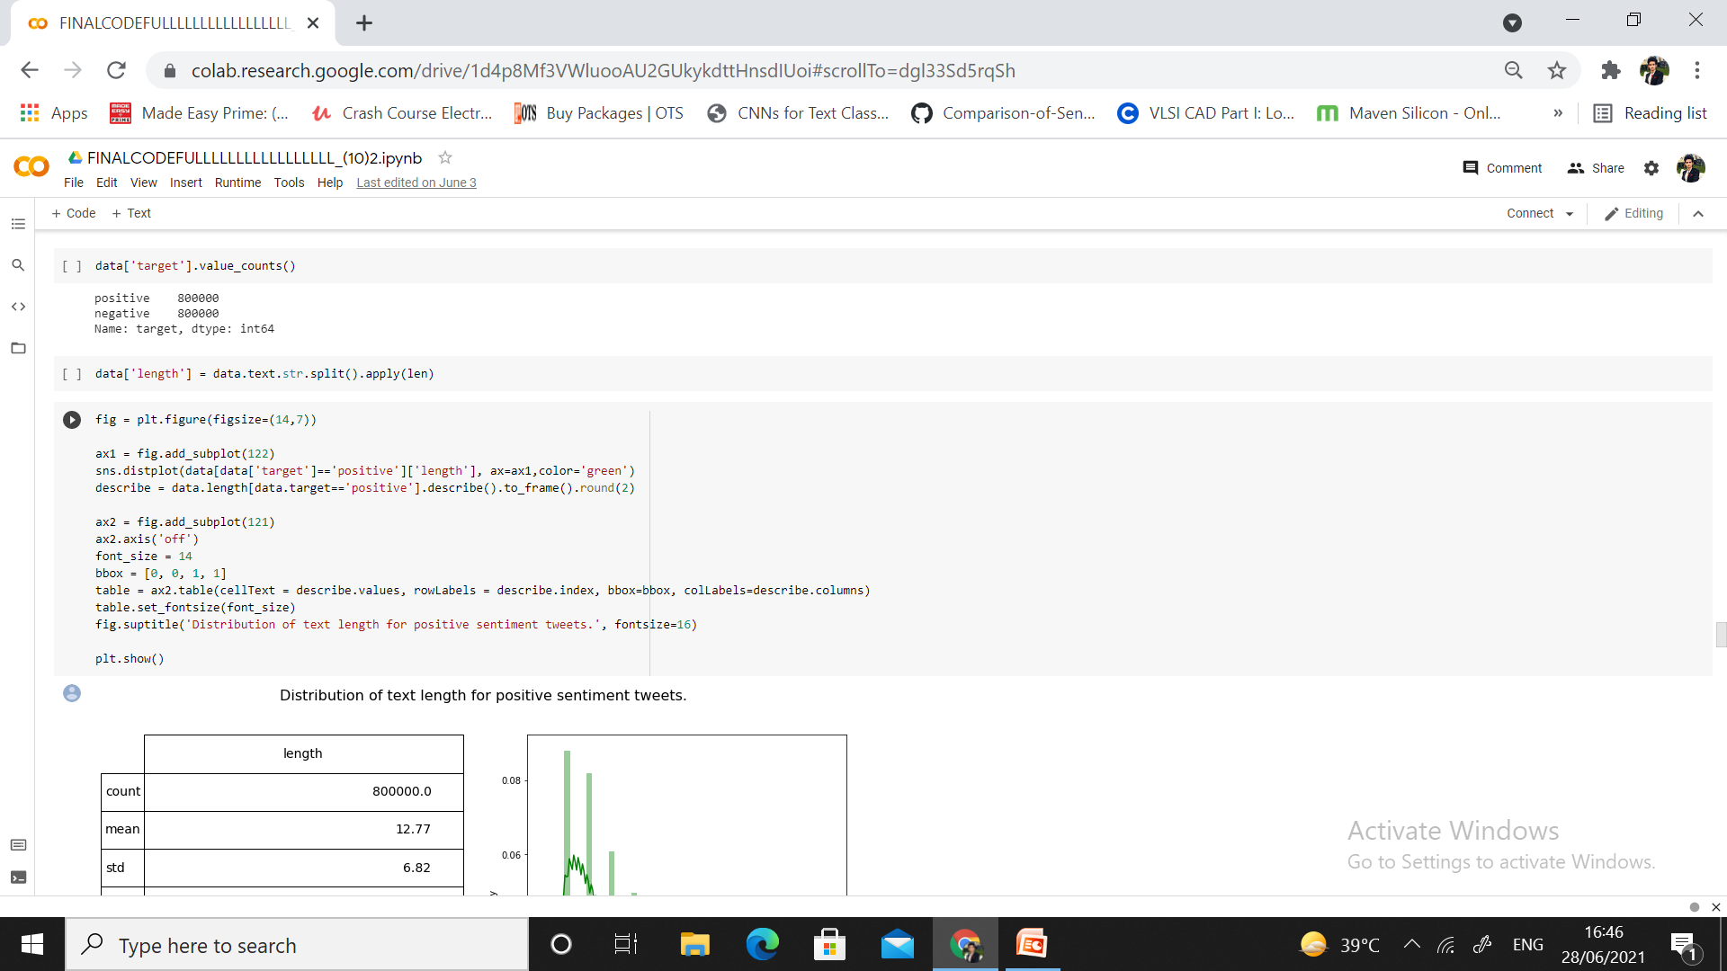
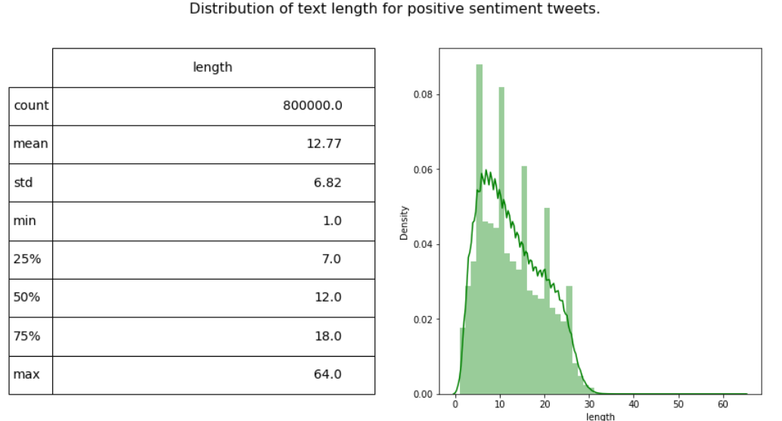
DISTRIBUTION OF TEXT LENGTH FOR POSITIVE TWEETS

Slide 22
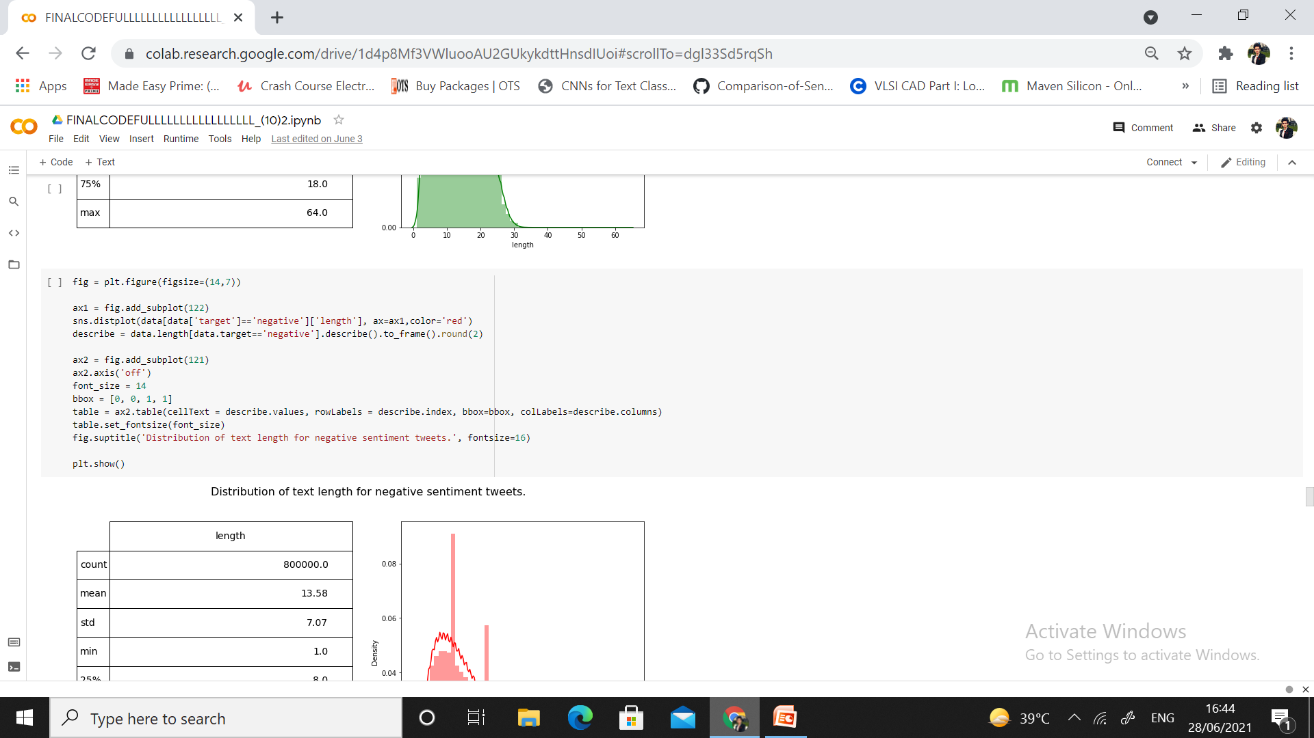
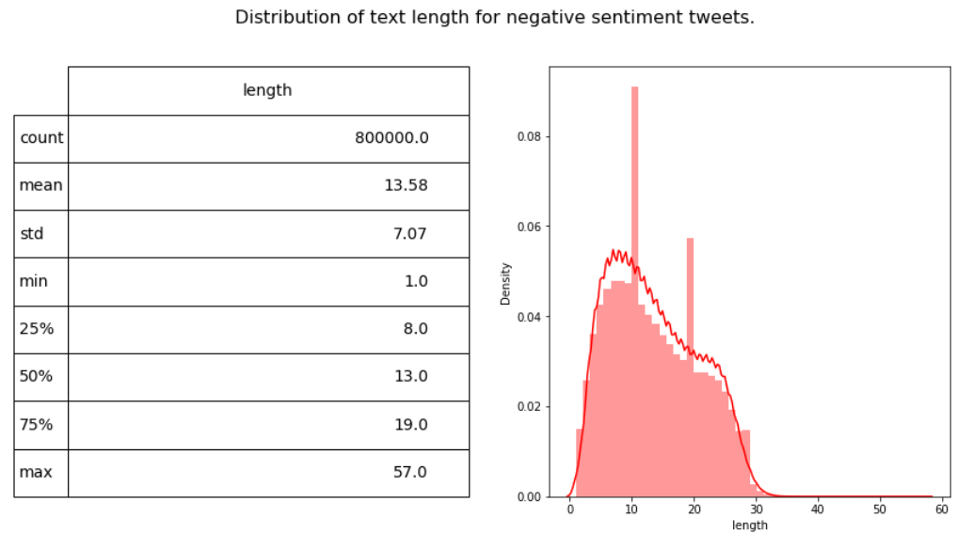
DISTRIBUTION OF TEXT LENGTH FOR NEGATIVE TWEETS

Slide 23
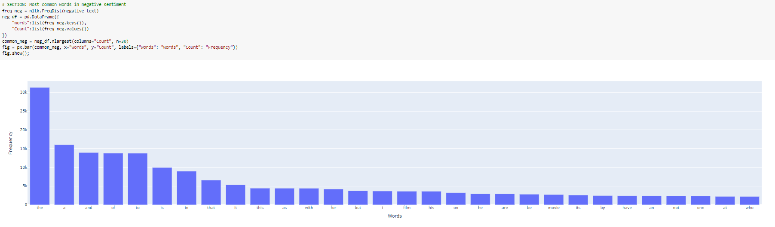
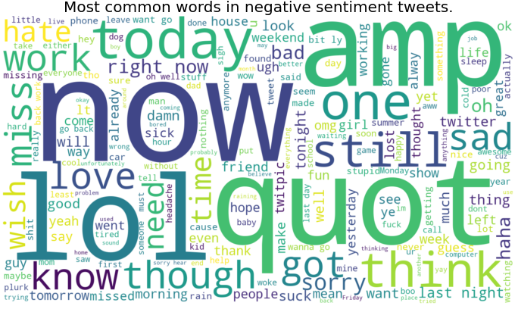
MOST COMMON WORDS IN NEGATIVE SENTIMENT

Slide 24
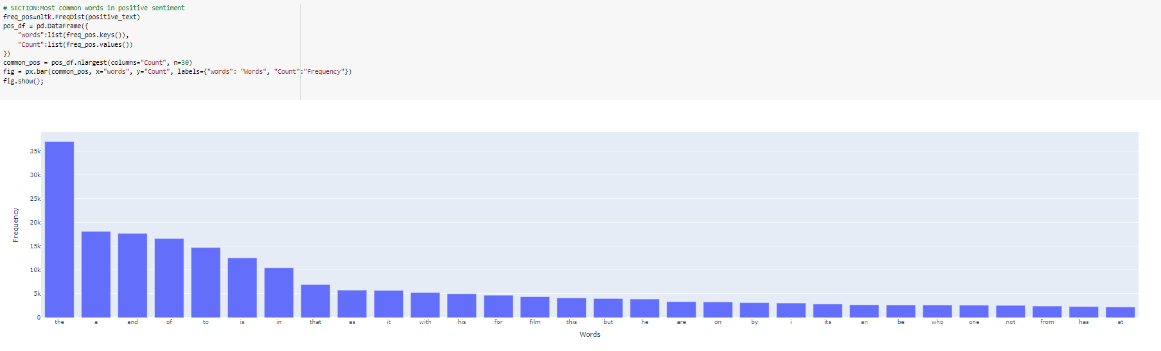
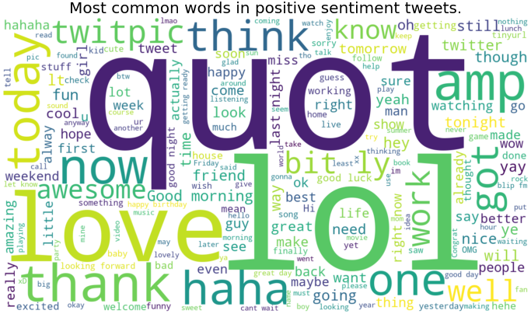
MOST COMMON WORDS IN POSITIVE SENTIMENT

Slide 25
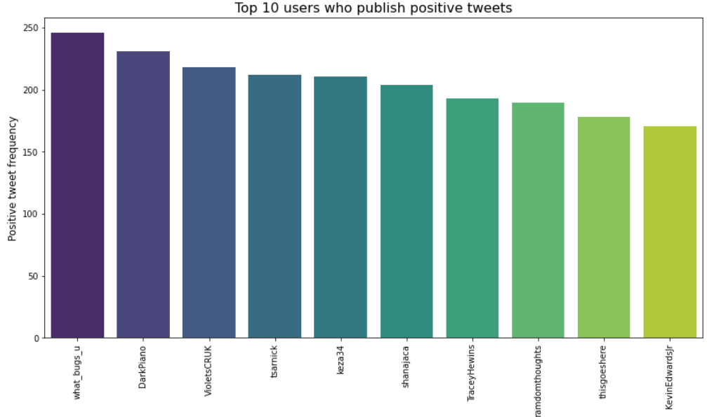
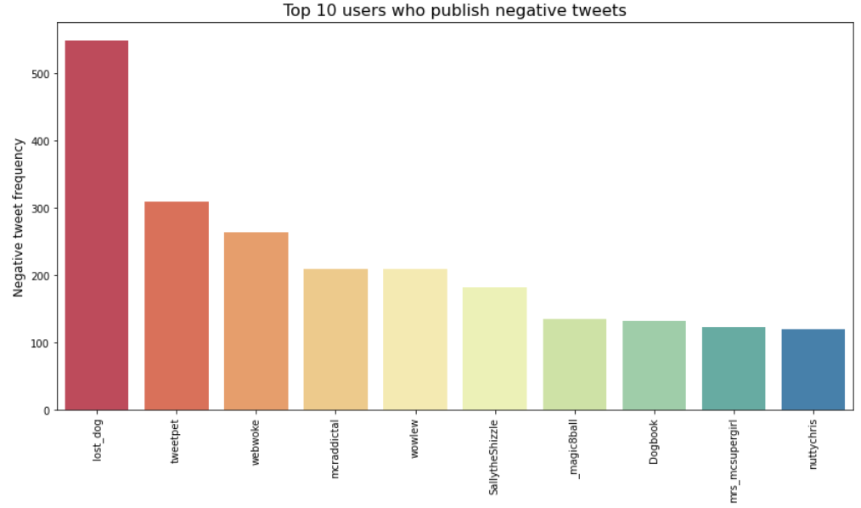

Slide 26
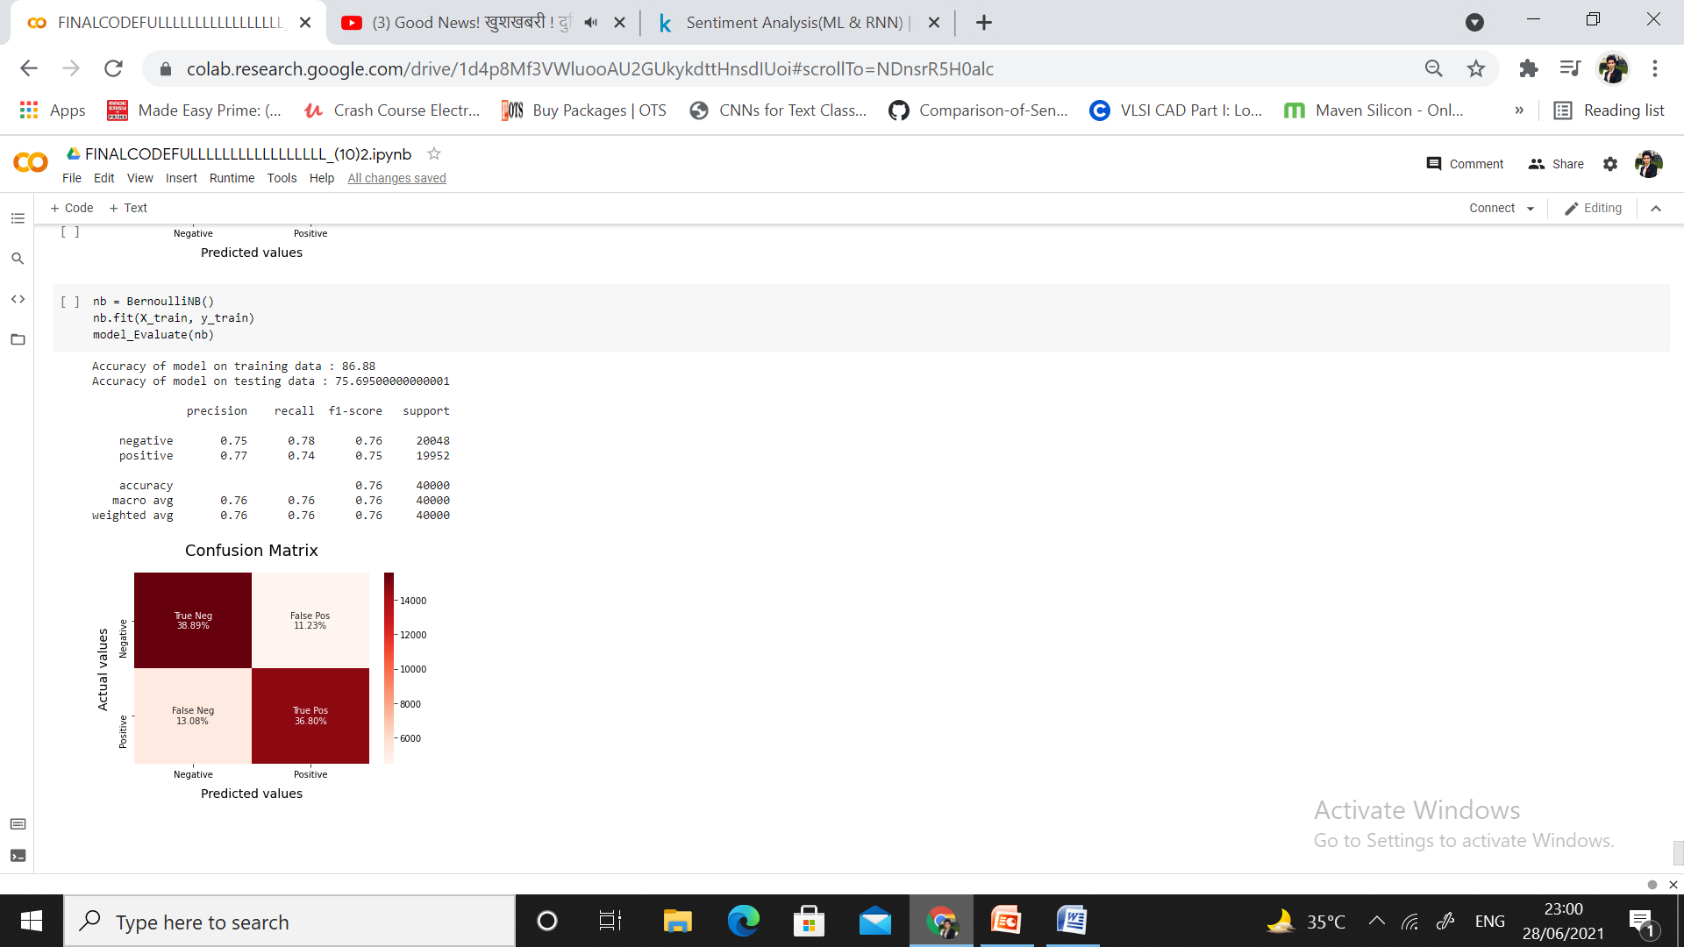
BERNOULLI NAIVE BAYES

Slide 27
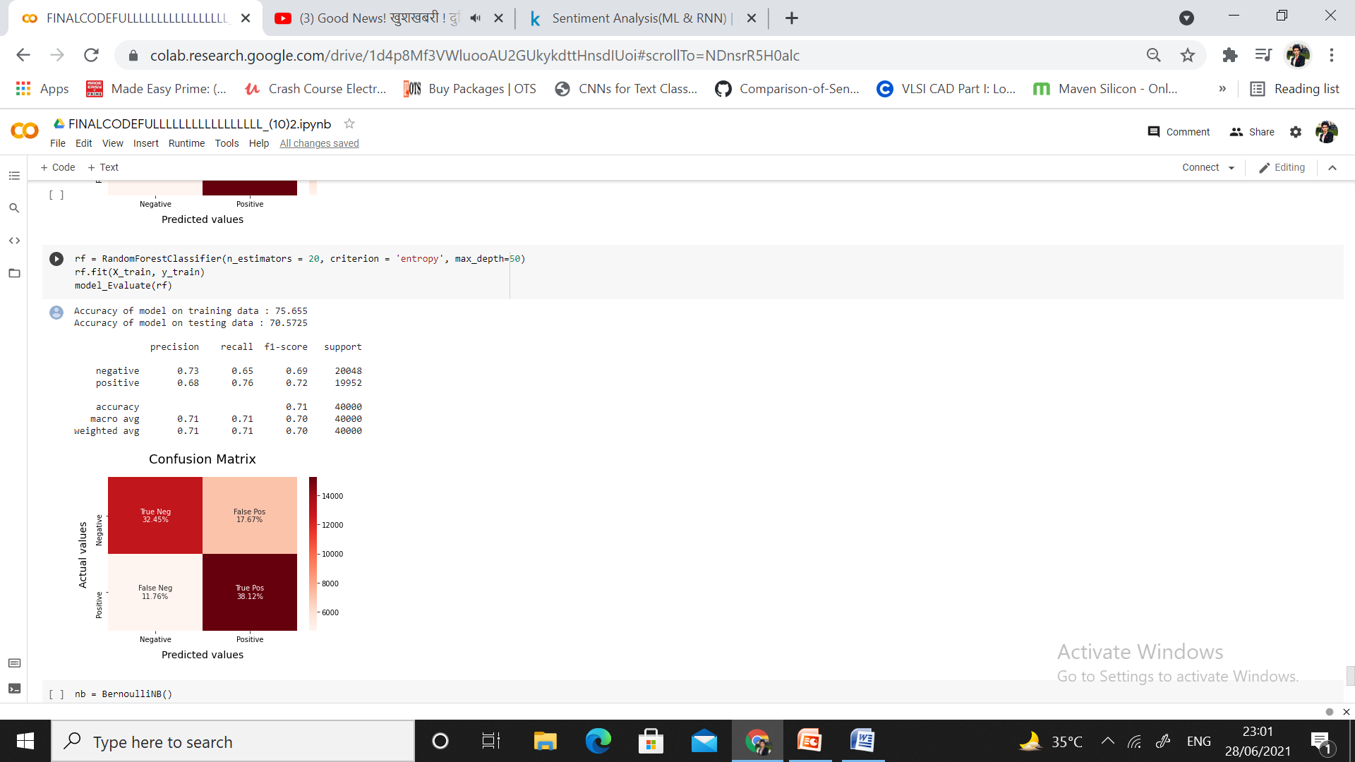
RANDOM FOREST

Slide 28
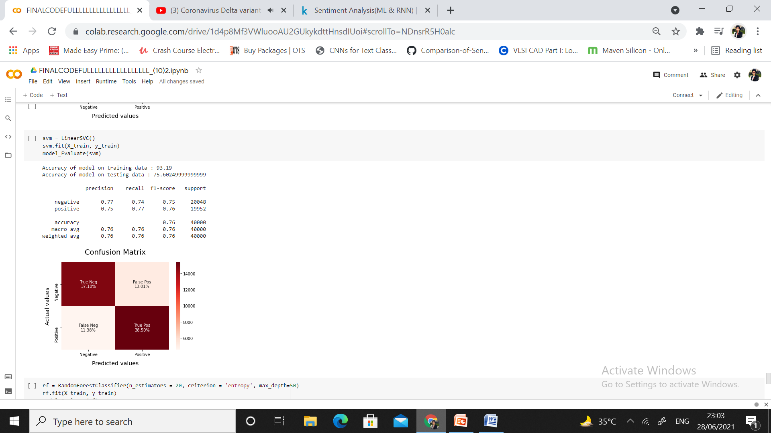
SUPPORT VECTOR MACHINE

Slide 29
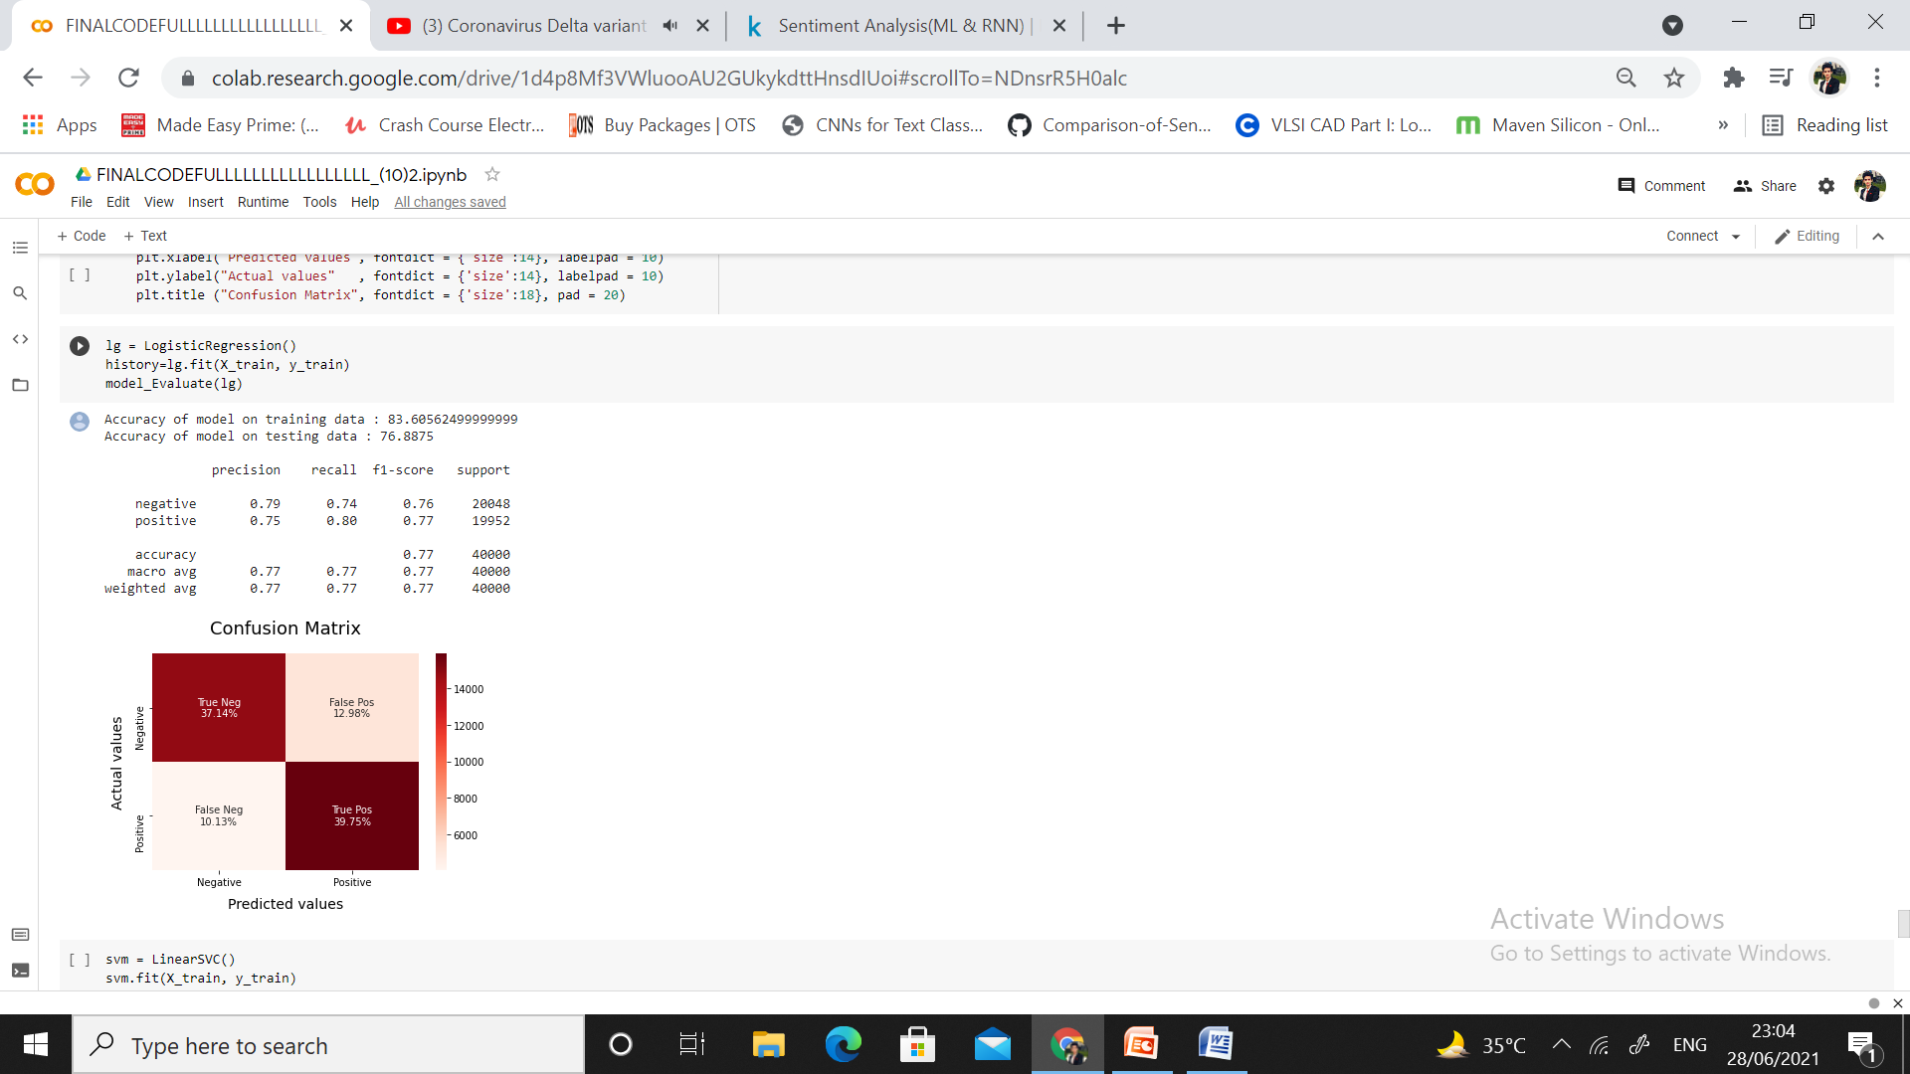
LOGISTIC REGRESSION

Slide 31
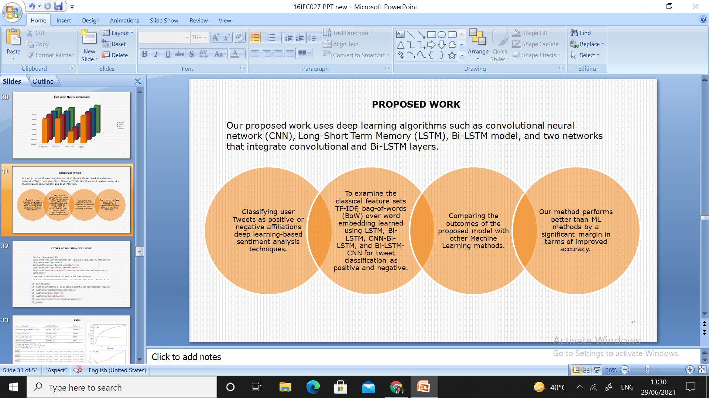
PROPOSED WORK
Our proposed work uses deep learning algorithms such as convolutional neural network (CNN), Long-Short Term Memory (LSTM), Bi-LSTM model, and two networks that integrate convolutional and Bi-LSTM layers.

Slide 32
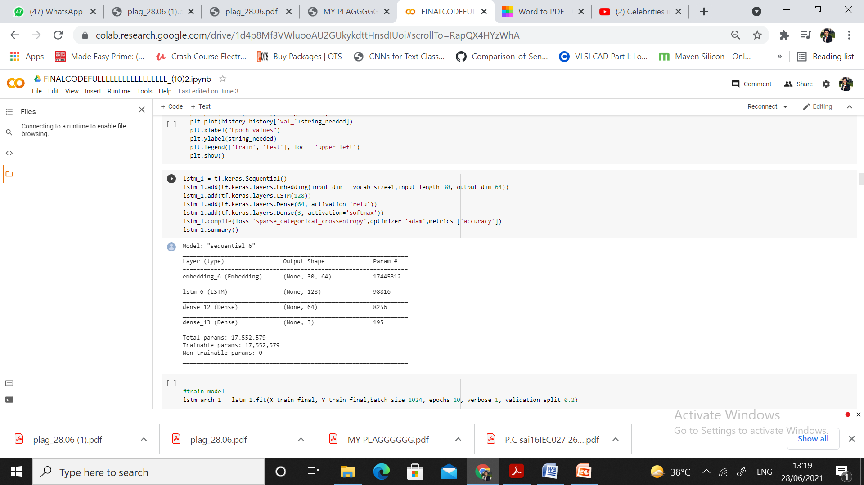
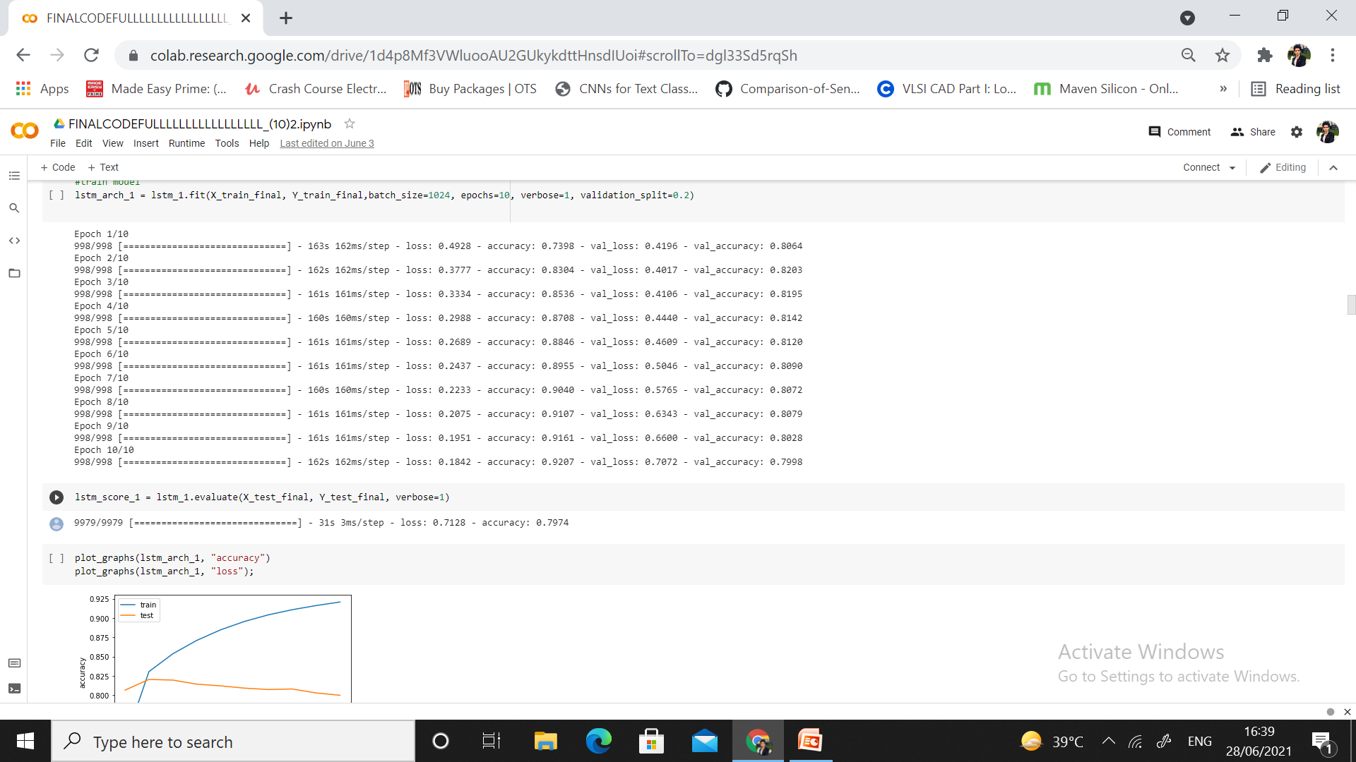
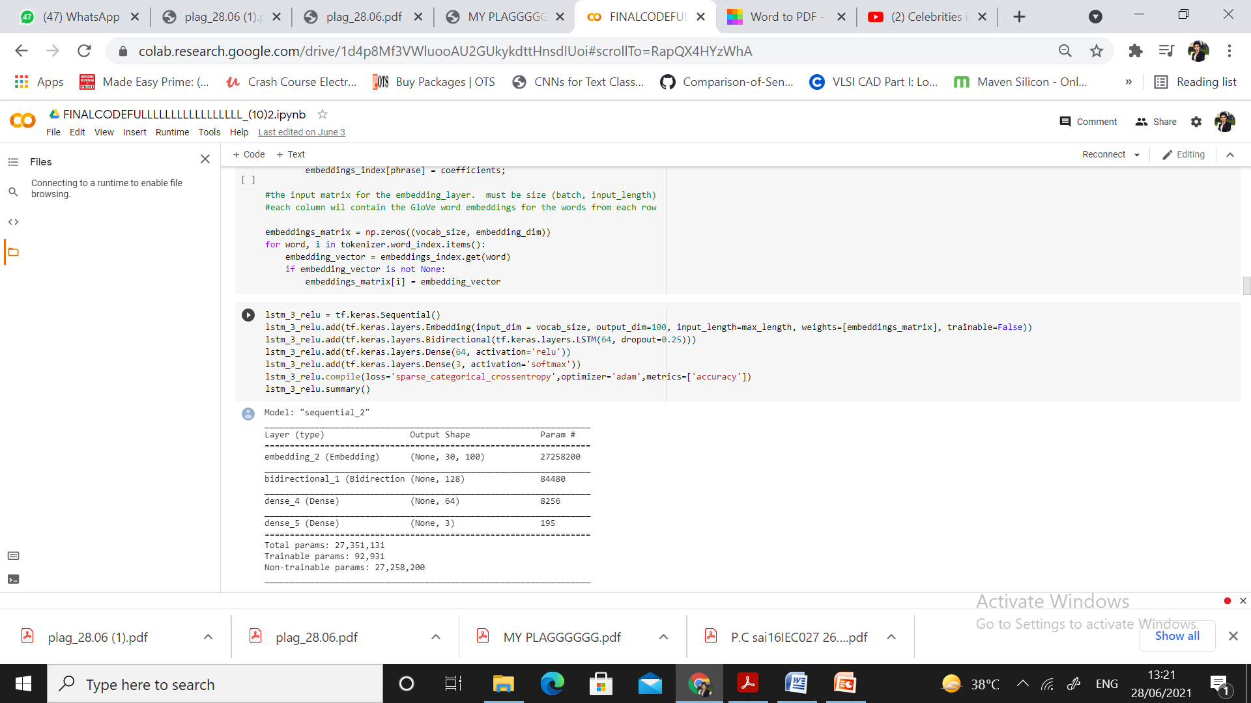
LSTM AND Bi-LSTMMODEL CODE

Slide 33
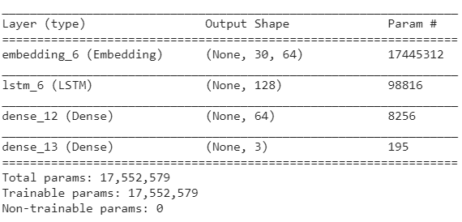
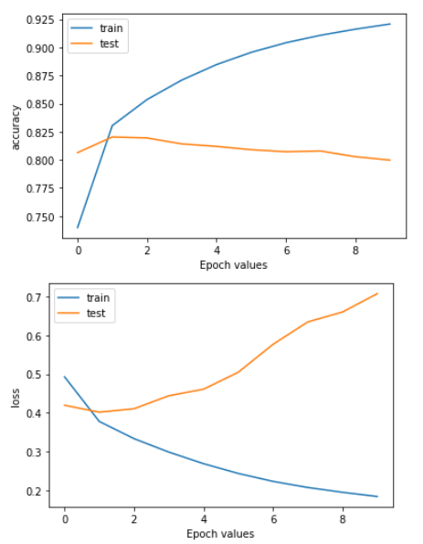
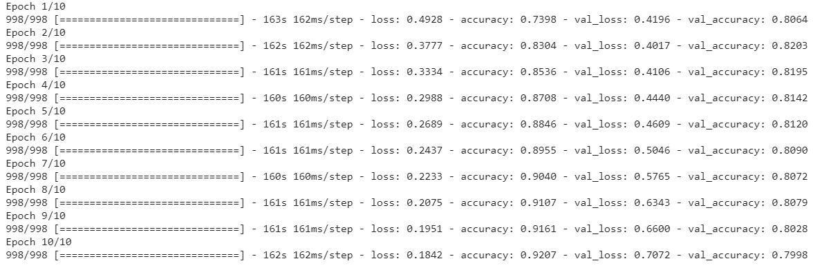
LSTM

Slide 34
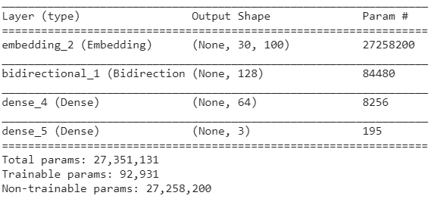
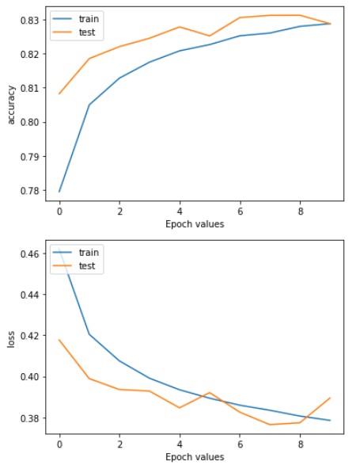
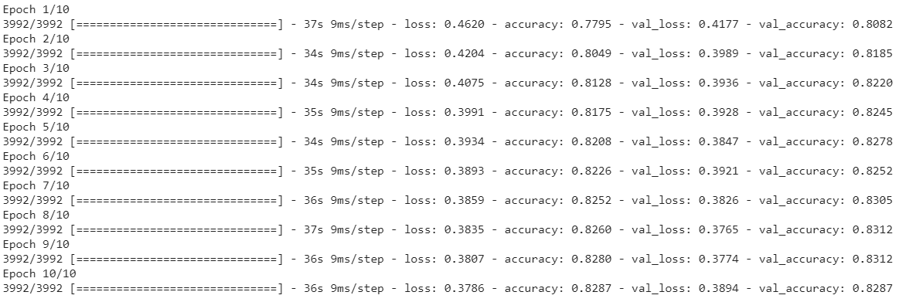
Bi-LSTM

Slide 35
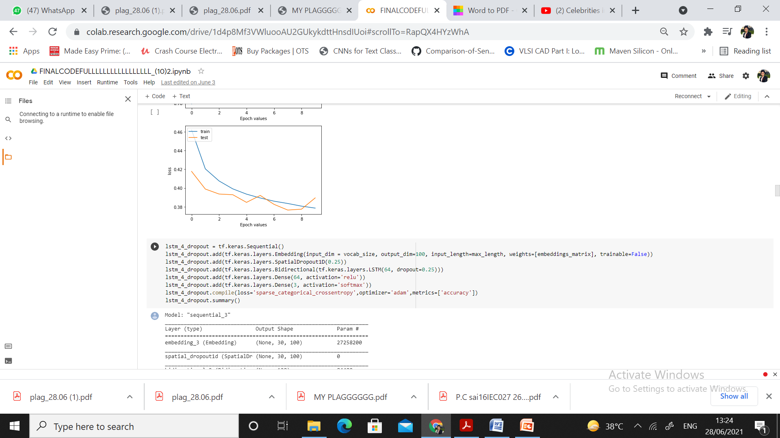
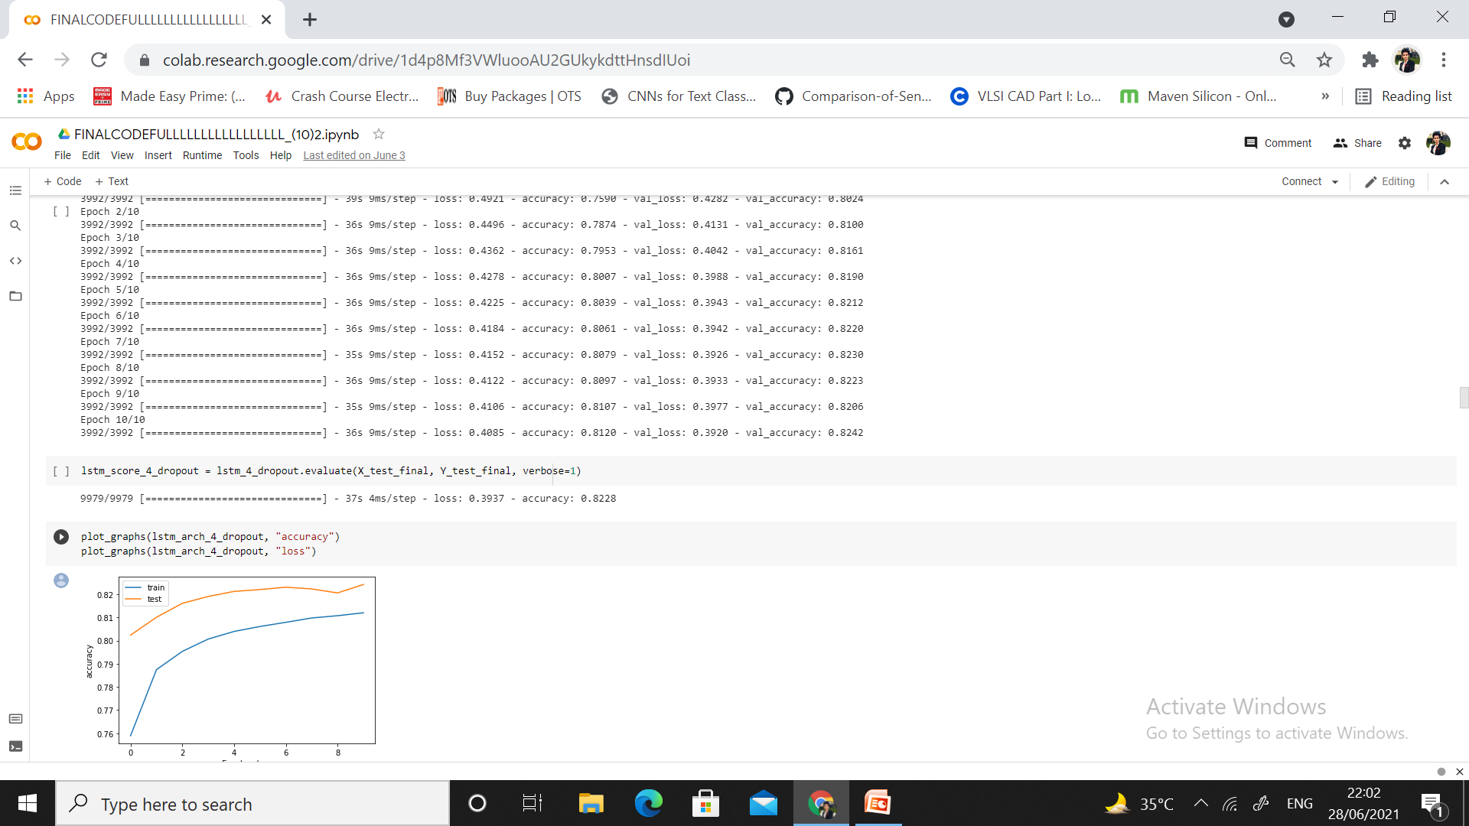
Bi-LSTM WITH SOME ADDITIONAL DROPOUT LAYER CODE

Slide 36
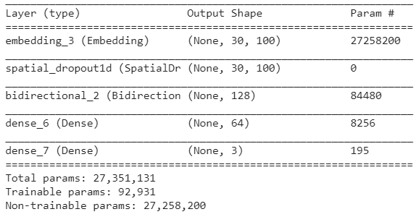
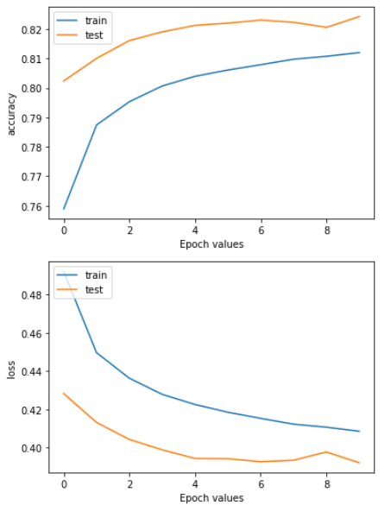
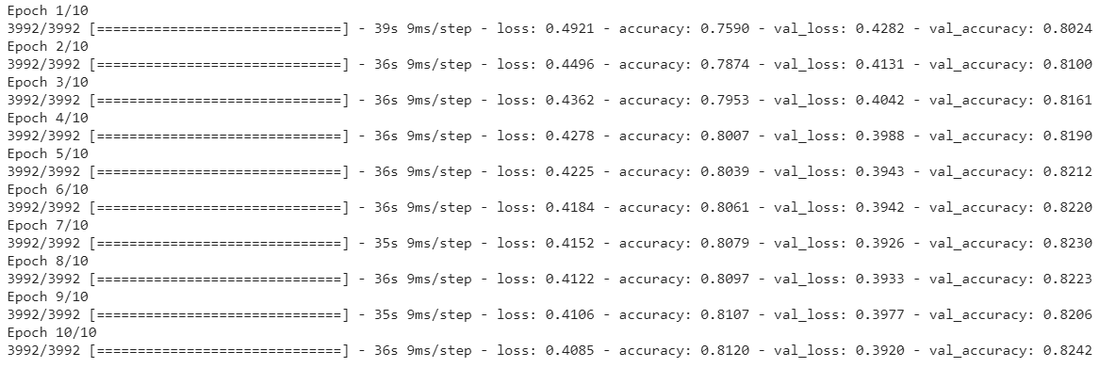
Bi-LSTM AND ADDITIONAL DROPOUT MODELACCURACY LOSS PLOT

Slide 37
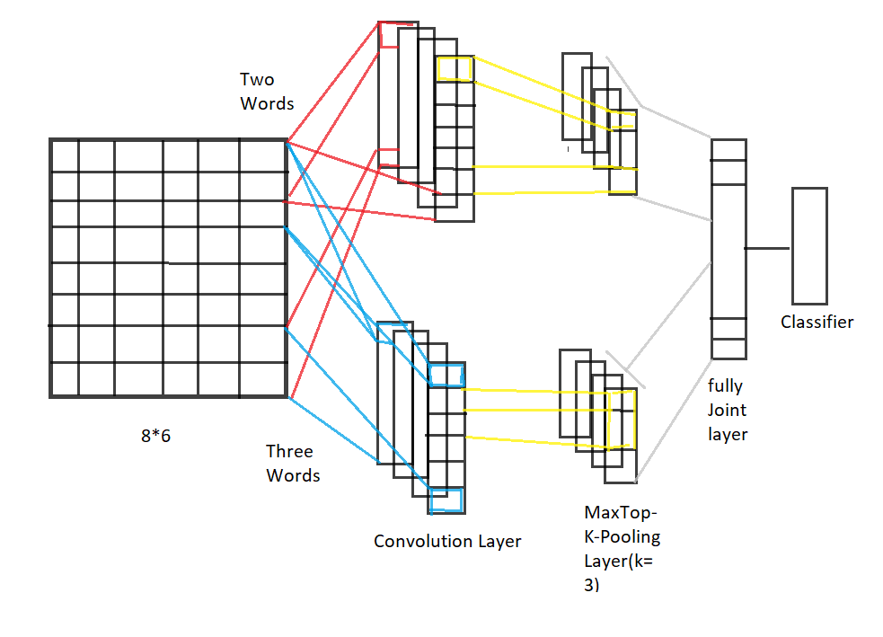
CNN TEXT CLASSIFICATION MODEL
A convolutional neural network is a type of layered neural network. The first layer represents the embedding layer which helps to embed the words into low-dimensional vectors. The second layer known as the layer of convolution, layer performs multiplication of the input vector, and weight vector is obtained to find the weighted sum.

Slide 38
CNN TEXT CLASSIFICATION MODEL
The third layer refers to the layer of max-pooling. Here a filter is needed and used to minimize the dimension of input to this layer by replacing values with the maximum among considered values. The fourth is the Dropout layer; this helps avoid overfitting problems and is active only at training time.

Slide 39
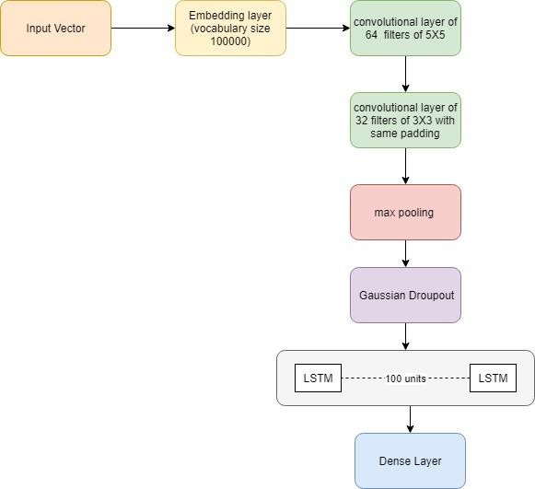
PROPOSED MODEL FLOW CHART

Slide 40
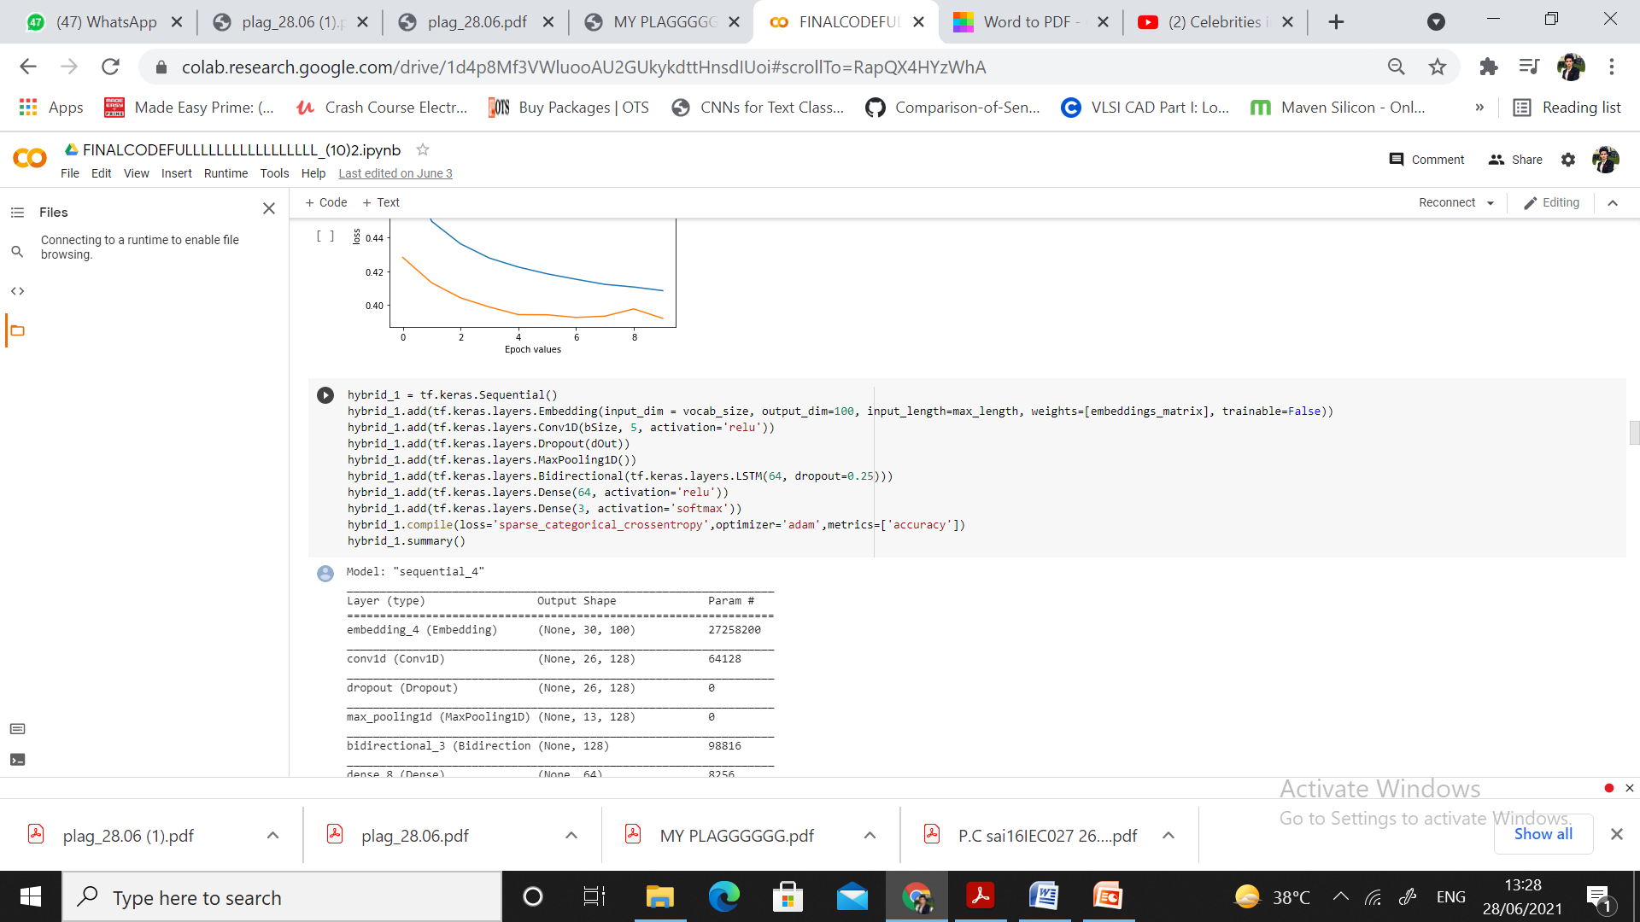
CODE FOR HYBRID MODEL 1 LAYERS (CNN+Bi-LSTM)

Slide 41
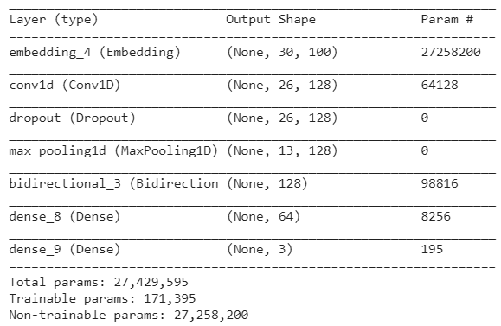
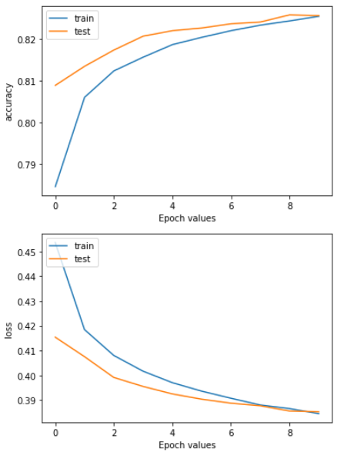
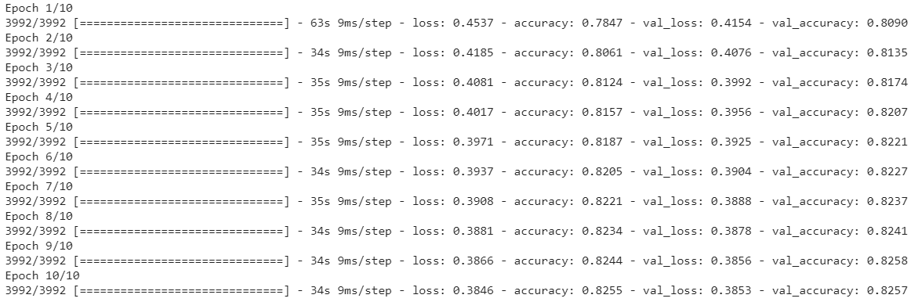
HYBRID MODEL 1 LAYERS (CNN+Bi-LSTM) + ACCURACY AND LOSS PLOTS

Slide 42

HYBRID MODEL 2 LAYERS (Bi-LSTM+CNN)

Slide 43



HYBRID MODEL 2 LAYERS (Bi-LSTM+CNN) + ACCURACY AND LOSS PLOTS

Slide 44

BASE PAPER ACCURACY AND F1-SCORE

Slide 46
Conclusion
In this proposed work, we have presented two models that aim to combine CNN and Bi-LSTM neural networks to achieve better performance on sentiment analysis tasks by a substantial margin. Our CNN+Bi-LSTM model does 2.69% better than a regular LSTM model. On the other hand, the Bi-LSTM-CNN model does 3% better than a regular LSTM model and 7.05% better than a Bernoulli NB model. We hope that this proposed model may aid the future development of accurate sentiment analysis tools.

Slide 47

APPLICATIONS

Slide 48
SCOPE OF WORK
For future research we can analyze the impact of the size of the dataset on the performance of the machine learning algorithms.
In this study, labeled data is positive, negative and neutral. In future work, consideration of emoji label and collecting of a better and large number of emoji datasets along with proper labelling may help to improve the results.
In this paper, we have introduced a novel model for deep sentiment representation by skillfully combining one-layer CNN and two-layer LSTMs. Due to convolution layer and pooling layer, the CNN makes it easy to automatically extract local features and reduce the computation complexity.
Besides, LSTM is skilled in learning sequence characteristics due to its ability to learn syntax features of linguistics. Therefore, our model achieves good performance on sentiment classification.
In the future work, we may study the combination of the bag-of-word model and word embedding technology to produce better pre-training feature as the input of network, and meanwhile change the way that we combine CNN and LSTM in our model.
.

Slide 49
TIME PLAN
Months Tasks | Oct 20-Dec 20 | Dec 20-Jan 21 | Jan 21– Feb 21 | Feb 21– March 21 | Feb 21 - March 21 | Mar 21 – Apr 21 | Mar 21– Apr 21 | Apr 21- May 21 | Apr 21- May 21
 | 1 | 2 | 3 | 4 | 5 | 6 | 7 | 8 | 9
Course work
Study and Review of Literature Survey
Problem Finding
Objective 1 Completion
Objective 2 Completion
Objective 3 Completion
Objective 4 Completion
Objective 5 Completion
Documentation

Slide 50
REFERENCES
Ramos, C., Augusto, J.C. and Shapiro, D., 2008. Ambient intelligence—the next step for artificial intelligence. IEEE Intelligent Systems, 23(2), pp.15-18.
Zhang, J., Zhan, Z.H., Lin, Y., Chen, N., Gong, Y.J., Zhong, J.H., Chung, H.S., Li, Y. and Shi, Y.H., 2011. Evolutionary computation meets machine learning: A survey. IEEE Computational Intelligence Magazine, 6(4), pp.68-75.
O’Shea, T. and Hoydis, J., 2017. An introduction to deep learning for the physical layer. IEEE Transactions on Cognitive Communications and Networking, 3(4), pp.563-575.
Palangi, H., Deng, L., Shen, Y., Gao, J., He, X., Chen, J., Song, X. and Ward, R., 2016. Deep sentence embedding using long short-term memory networks: Analysis and application to information retrieval. IEEE/ACM Transactions on Audio, Speech, and Language Processing, 24(4), pp.694-707.

Slide 51
THANK YOU

